Slide 1
Health Inequalities in Europe: Setting the Stage for Progressive Policy Action
Timon Forster
Alexander Kentikelenis
Clare Bambra

Slide 2
In some ways, the health of Europeans is better than ever

Slide 3
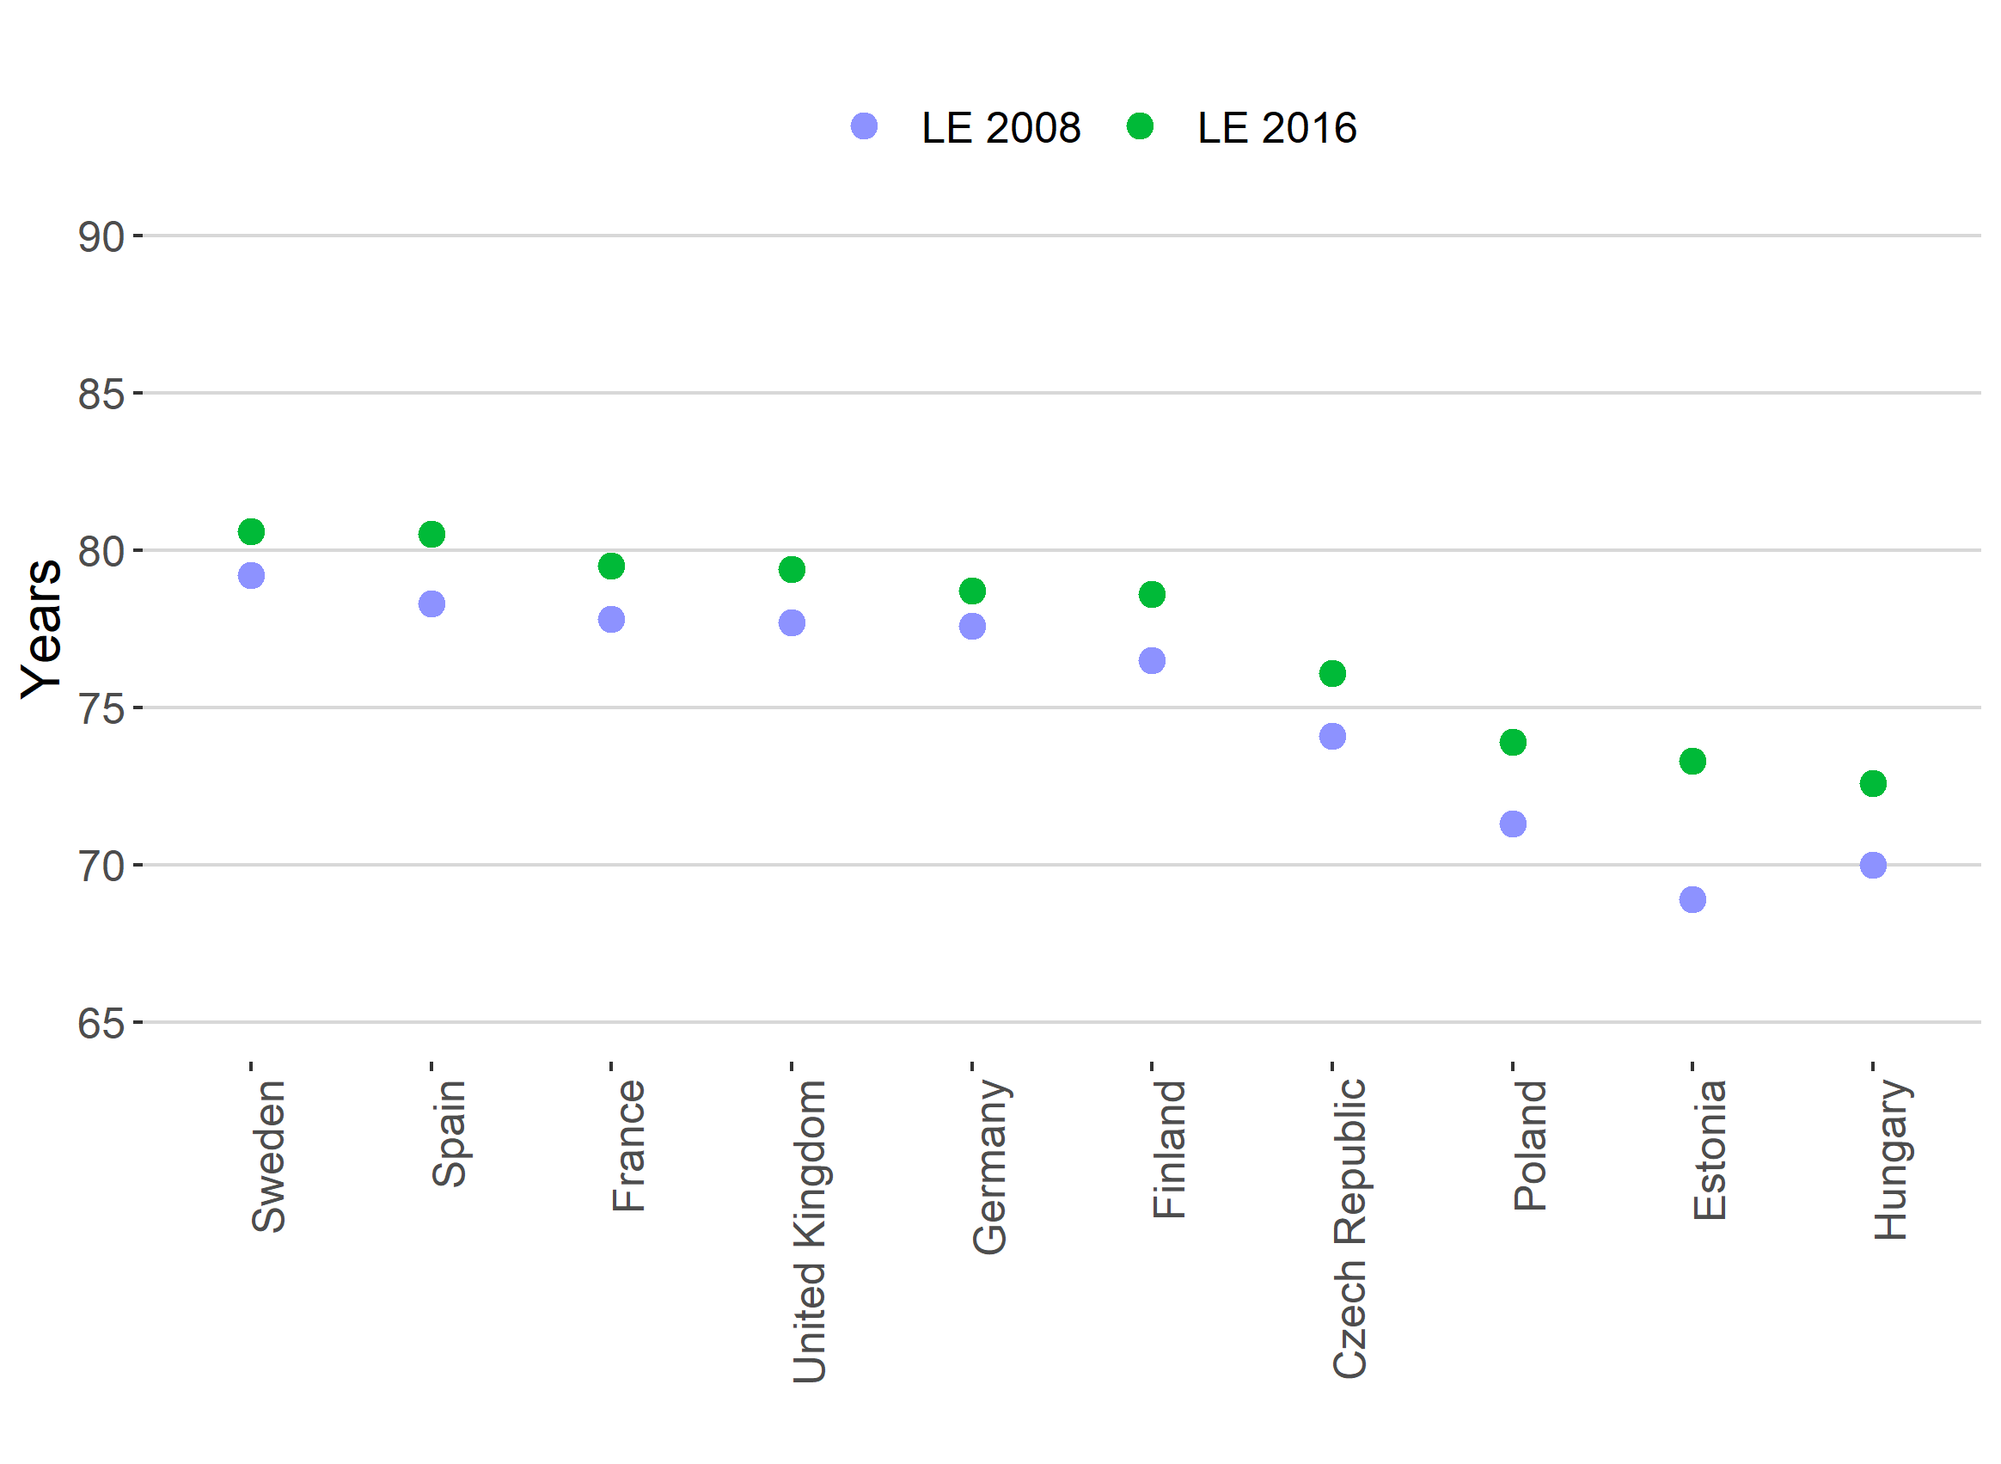
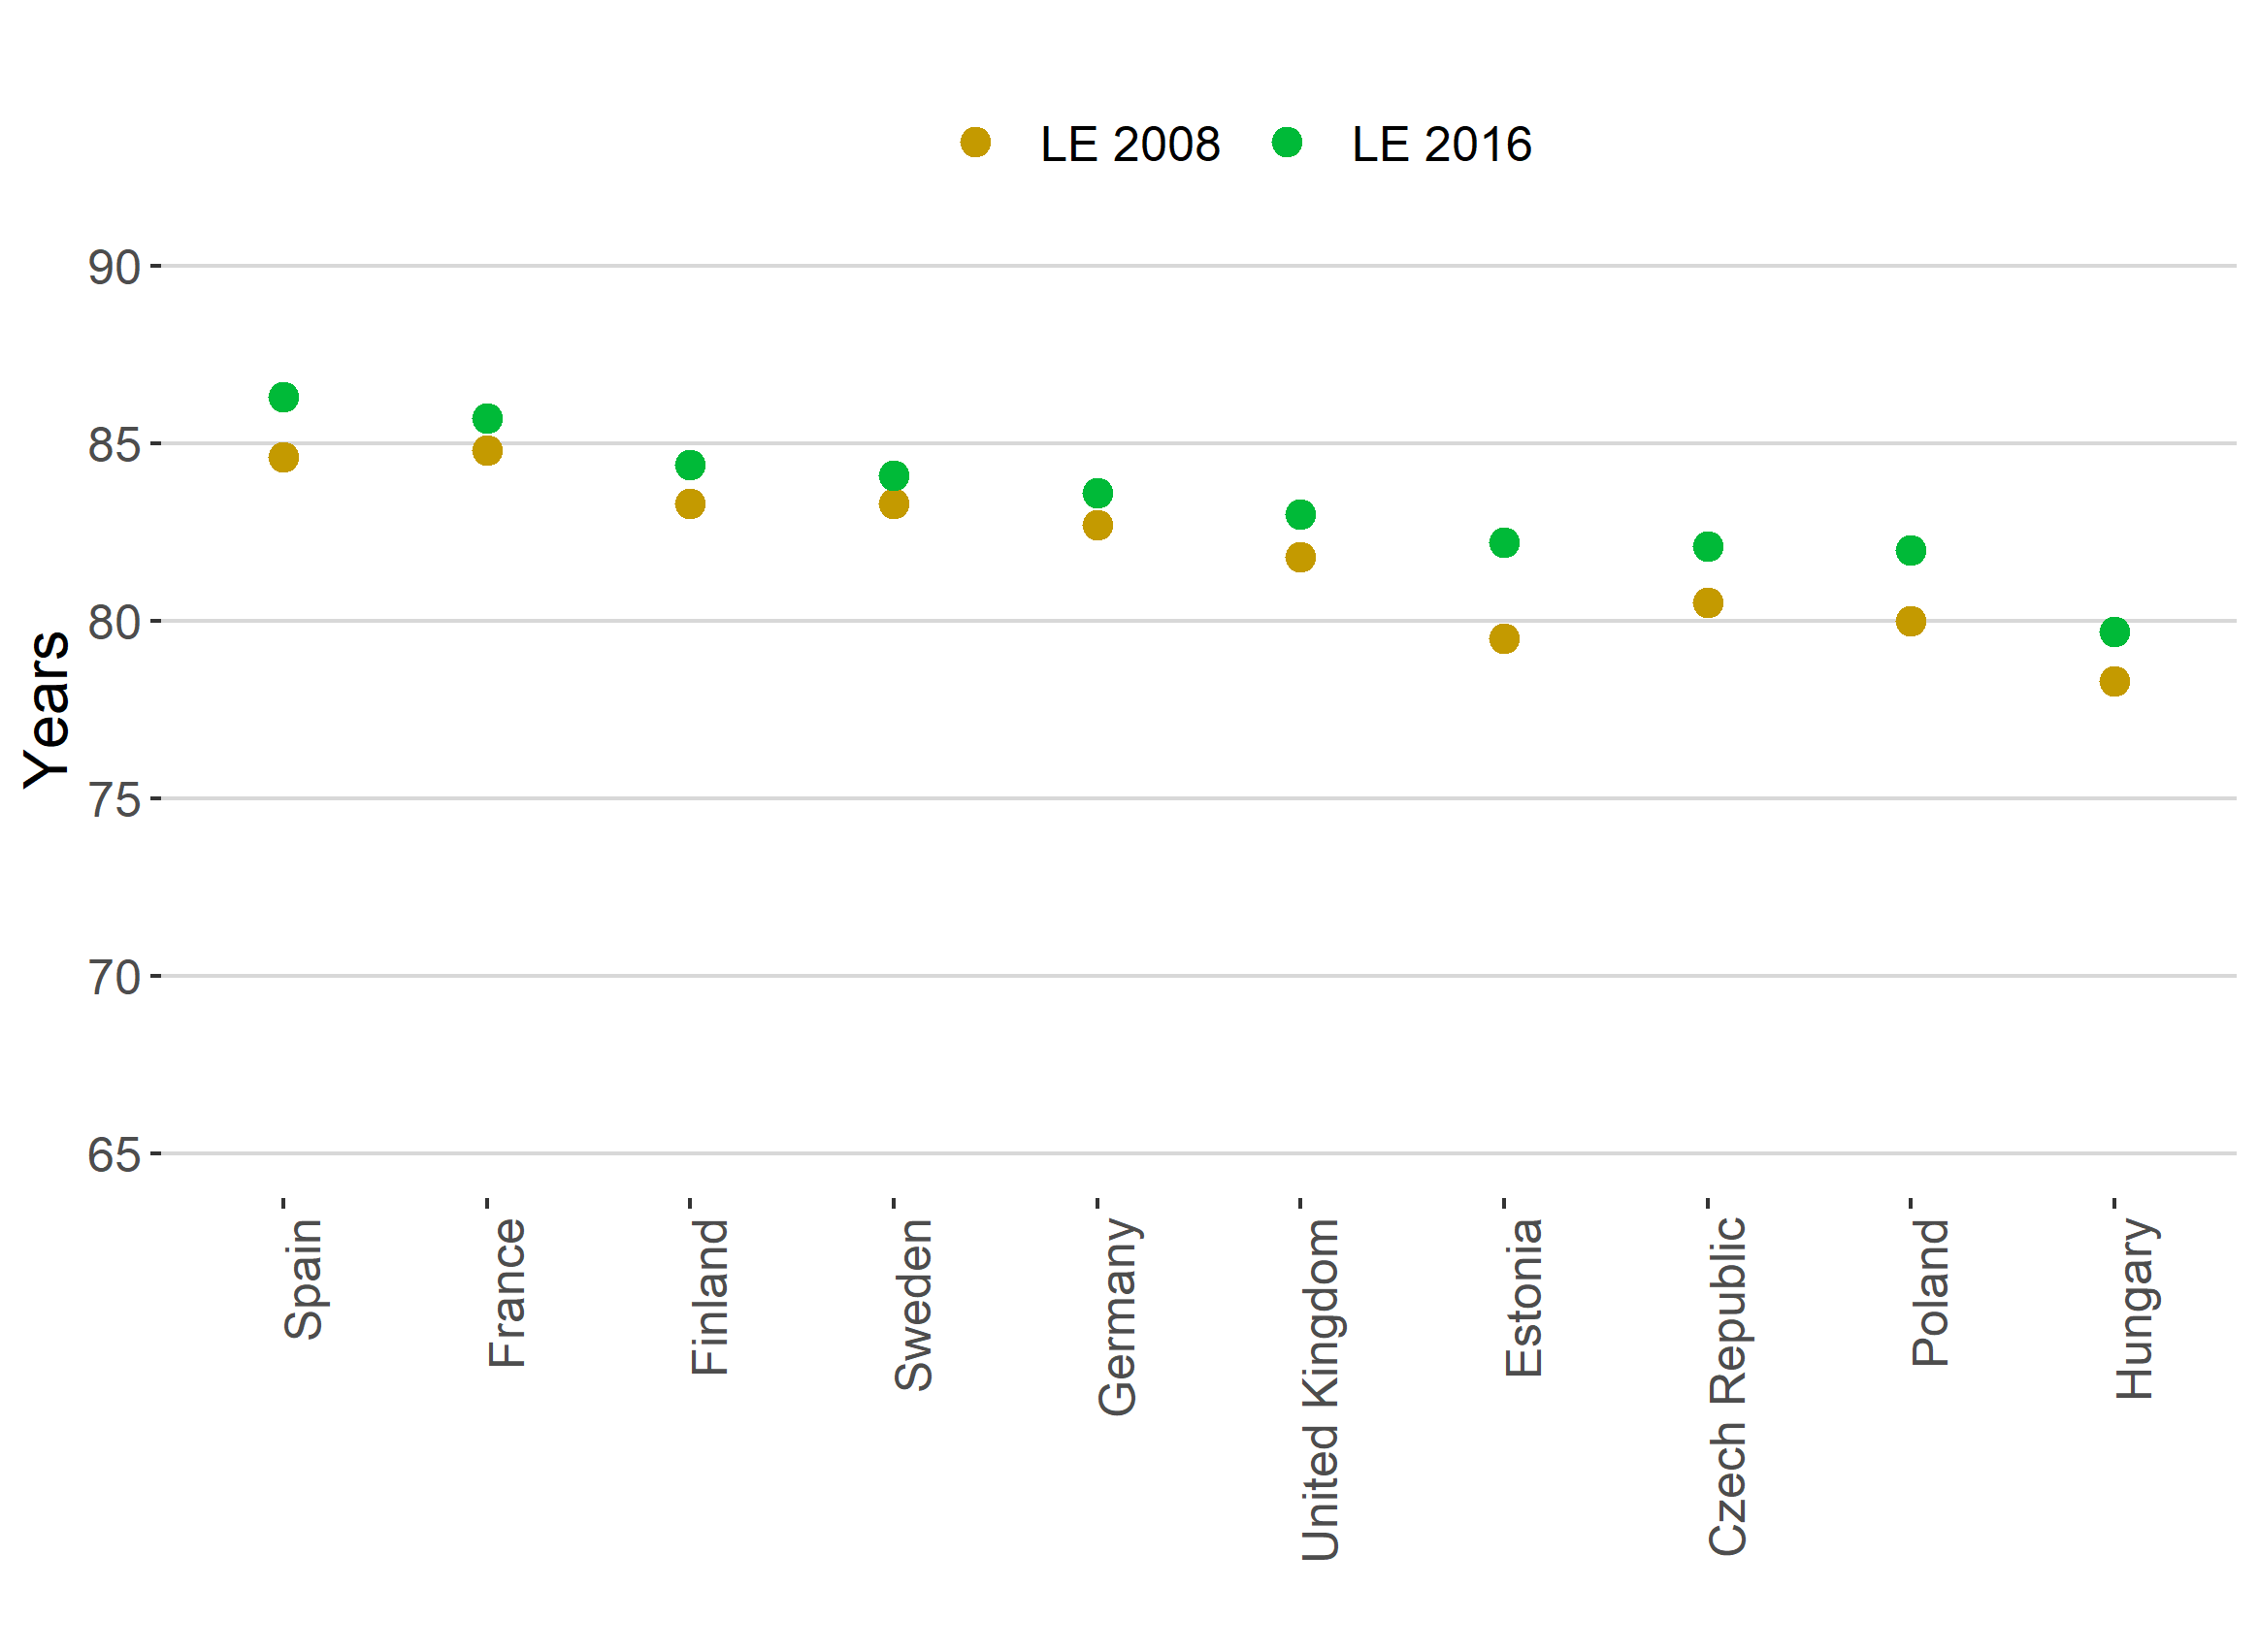
Life expectancy at birth
Men
Women
Source: Authors, based on data by Eurostat (2018).

Slide 4
But substantial inequalities in health persist

Slide 5
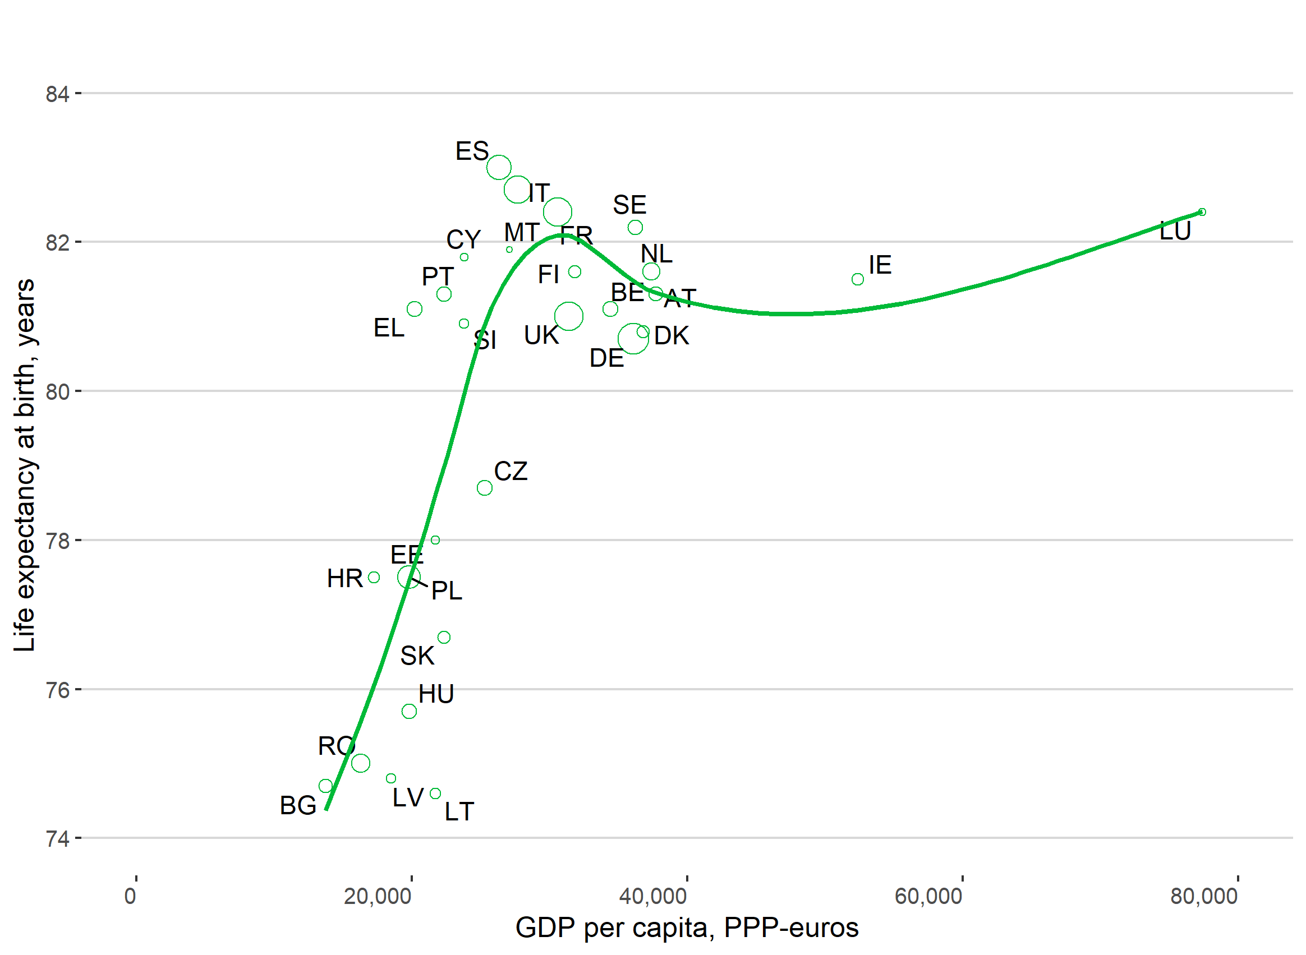
Between country inequalities
Note: Data refer to 2015. Observations are weighted by the relative population size, indicated by circle size.
Source: Authors, based on data by Eurostat (2018).

Slide 6
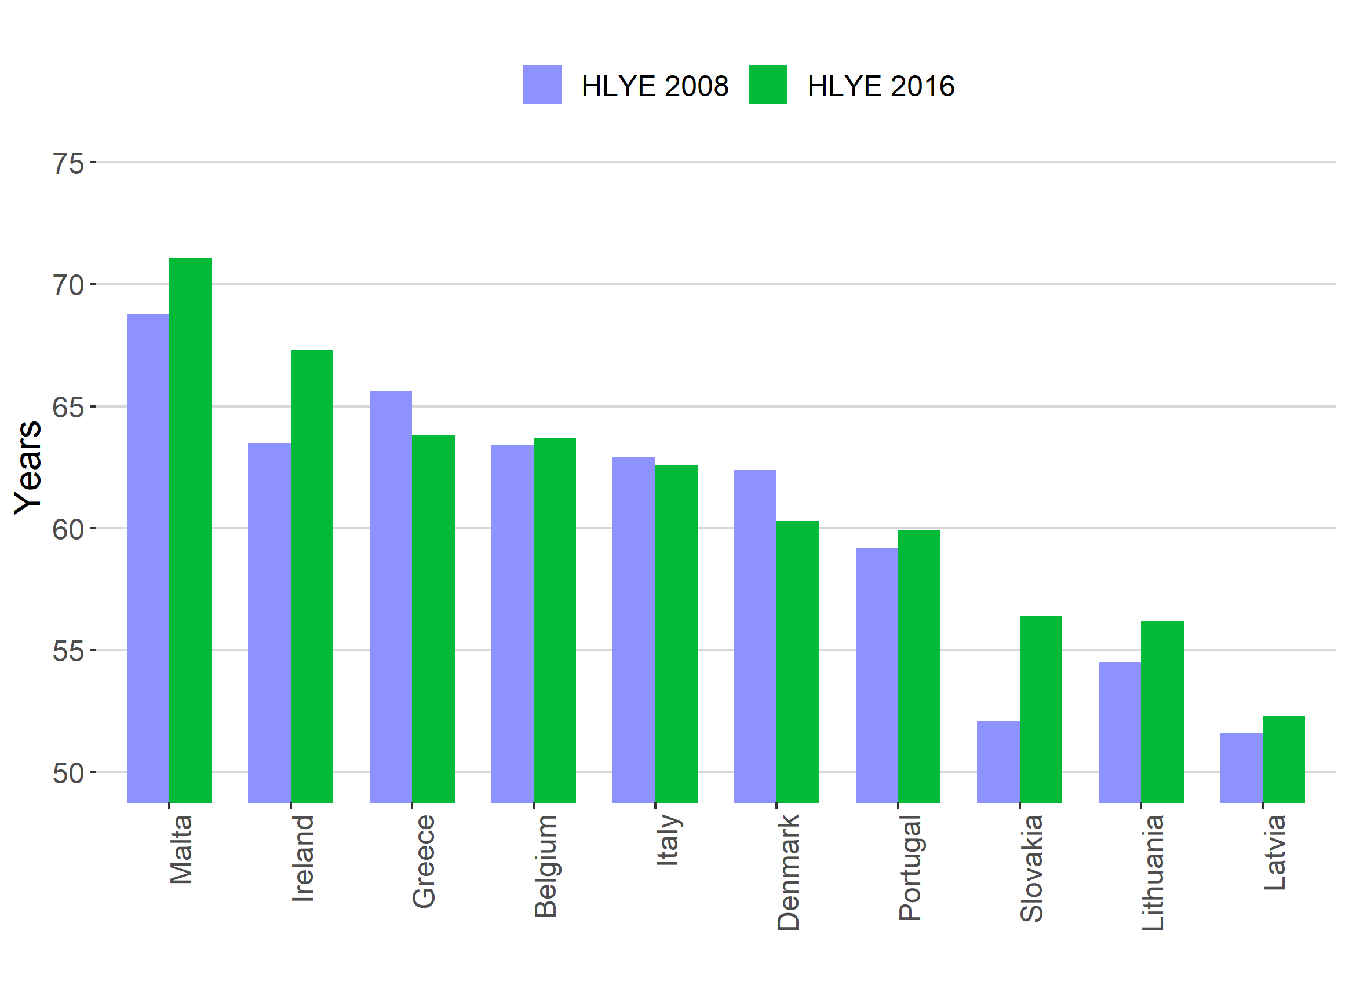
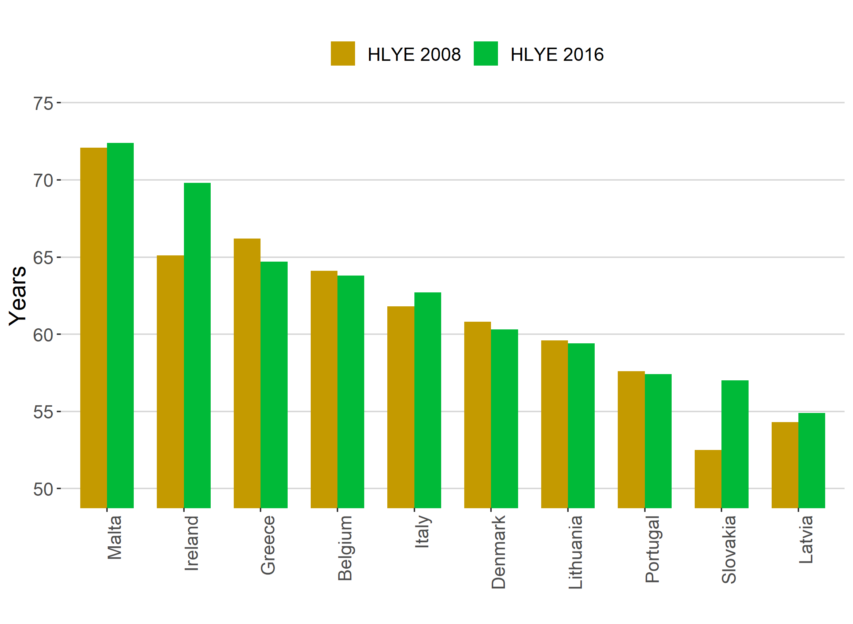
Between country inequalities _{(continued)}
Men
Women
Note: 2016 values for Italy refer to 2015.
Source: Authors, based on data by Eurostat (2018).

Slide 7
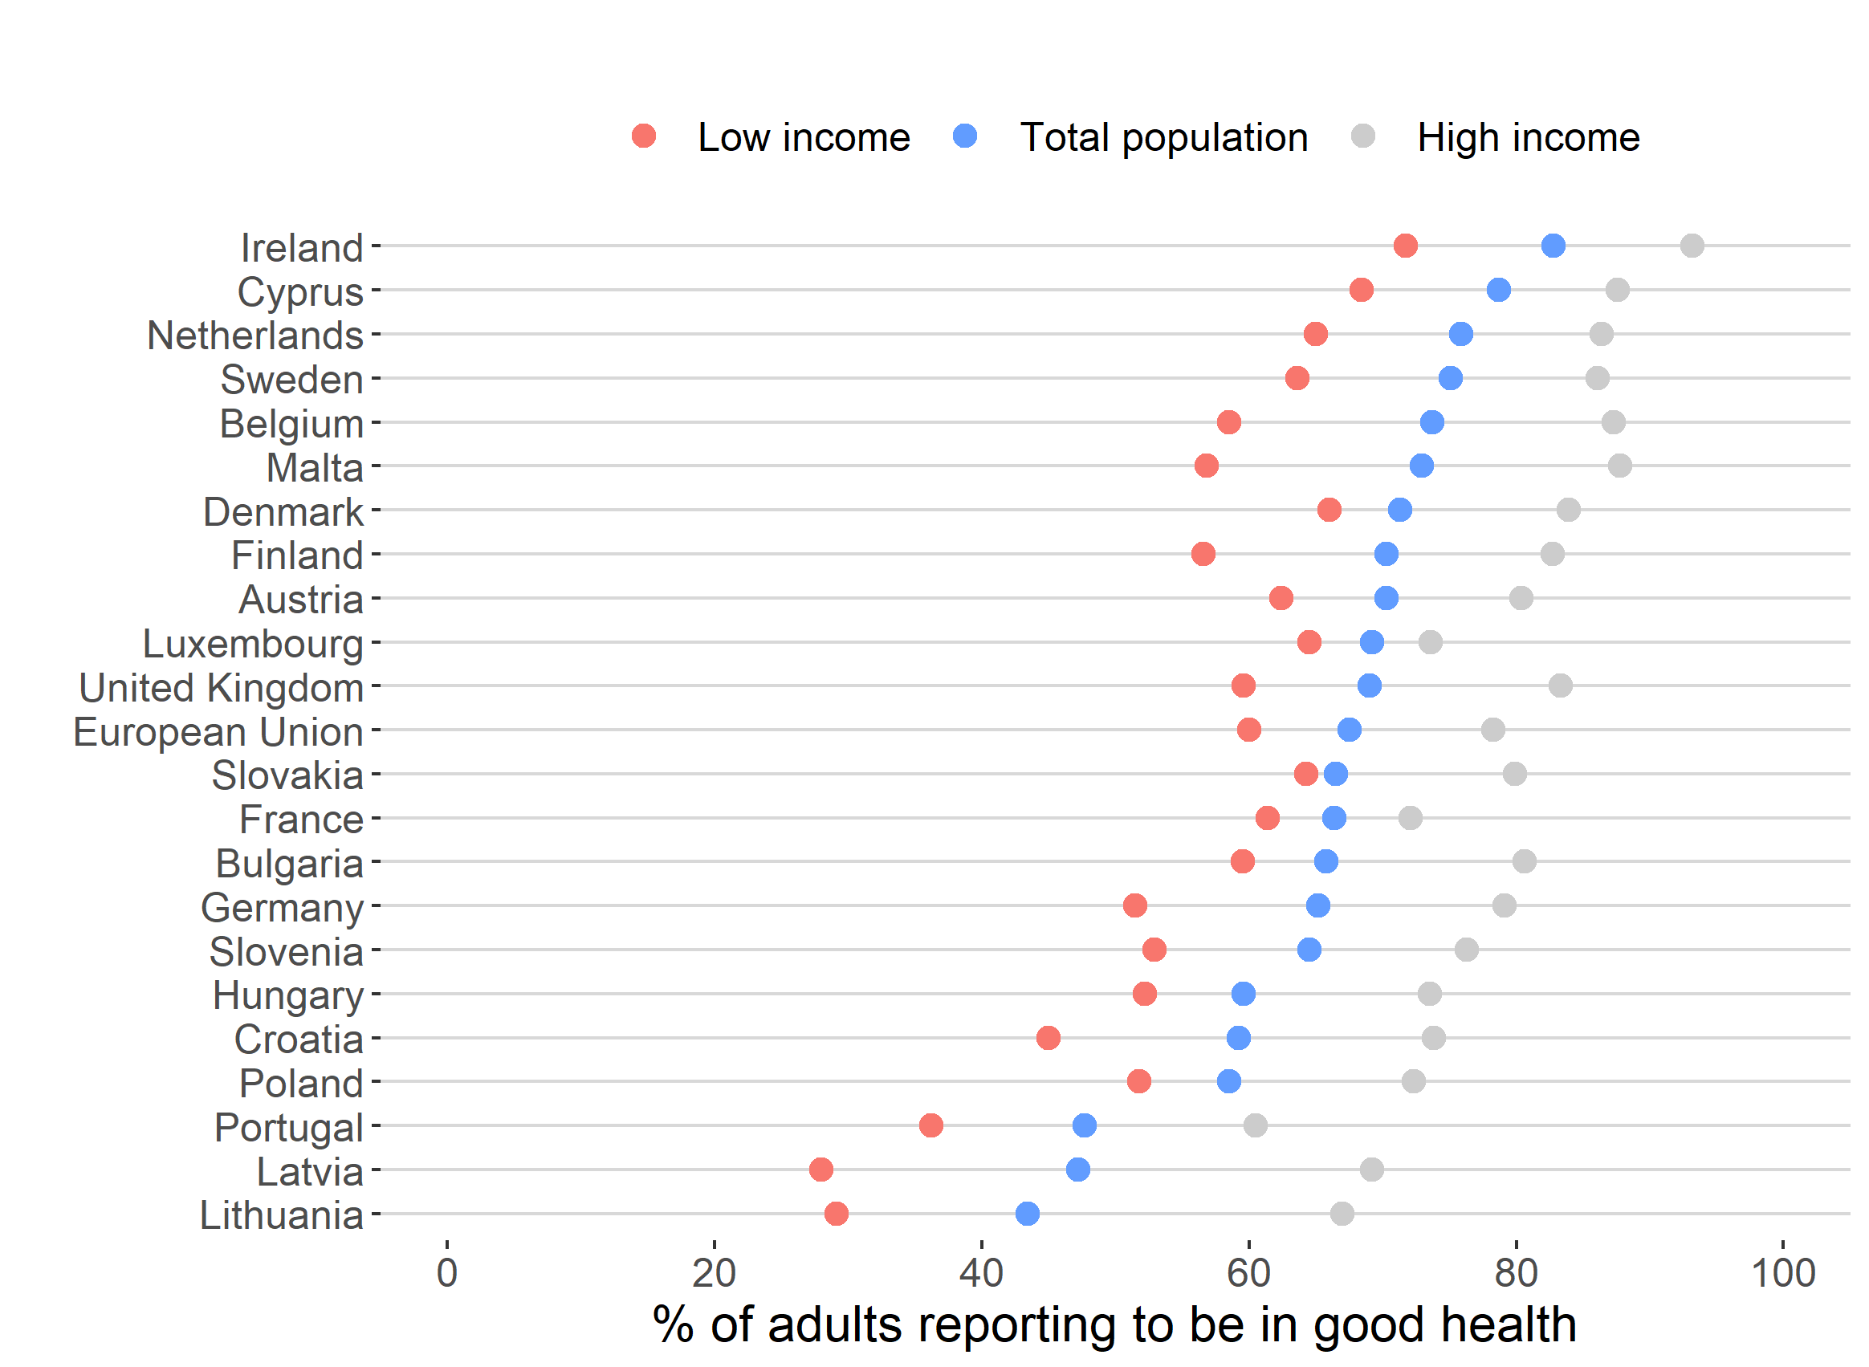
Within country inequalities
Note: Data refer to 2016.
Source: Authors, based on data by Eurostat (2018).

Slide 8
How to understand health inequalities?

Slide 9
Social gradients in health

Slide 10
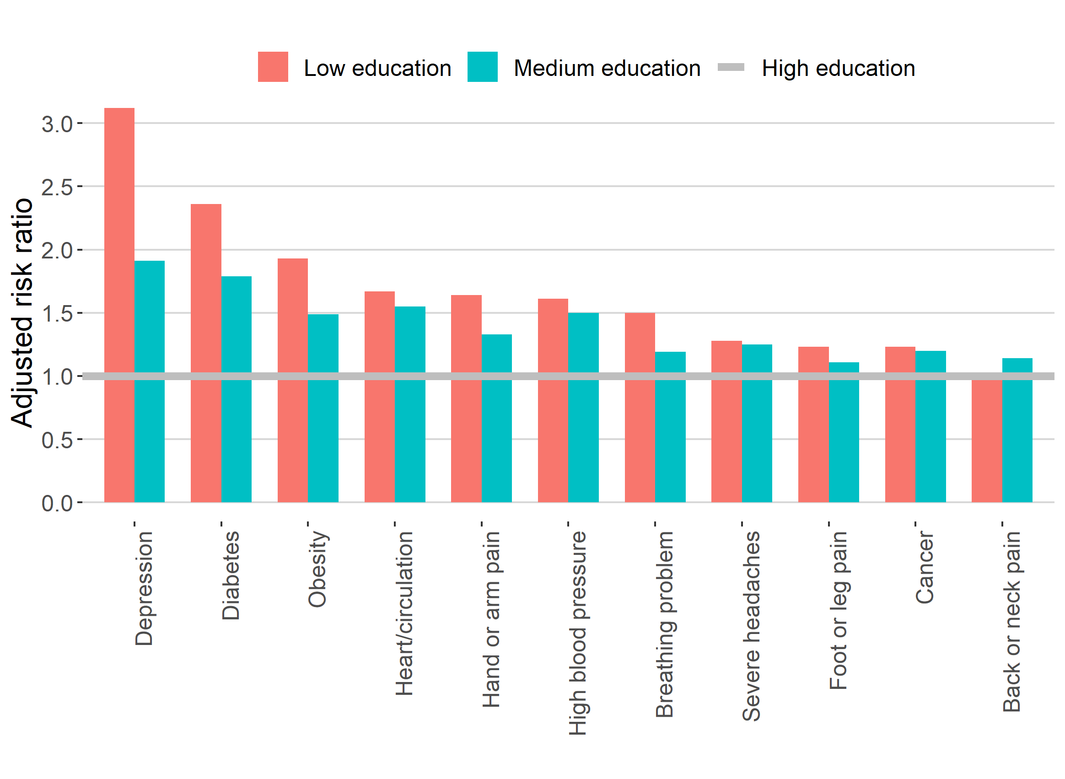
Non-communicable diseases in Europe
Note: Data refer to 2014.
Source: Authors, based on data by McNamara et al. (2017) from the European Social Survey 2014.

Slide 11
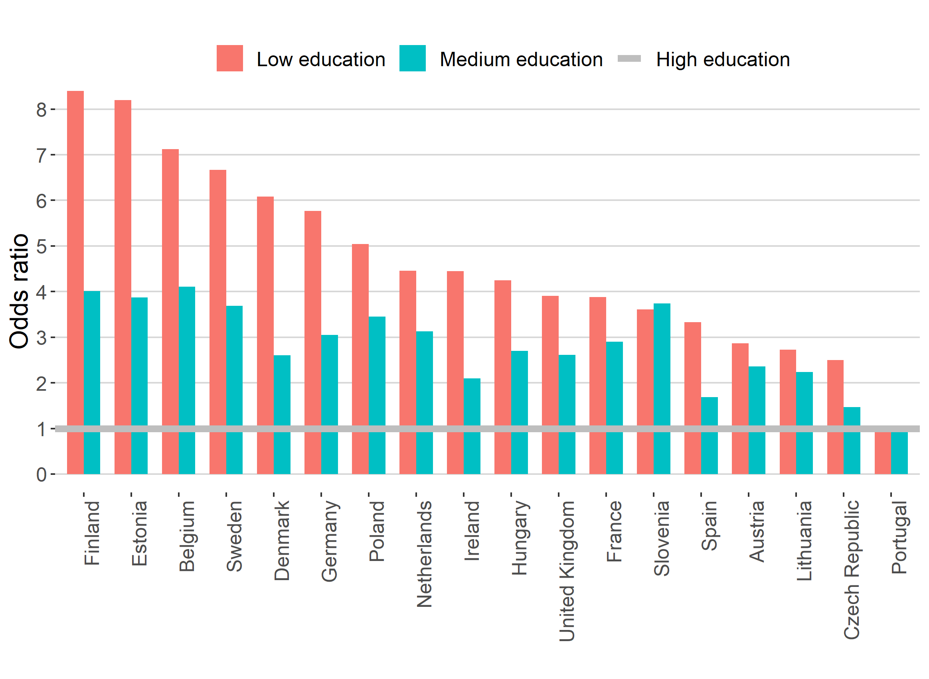
Risk of being a daily smoker by education
Note: Data refer to 2014.
Source: Authors, based on data by Huijts et al. (2017) from the European Social Survey 2014.

Slide 12
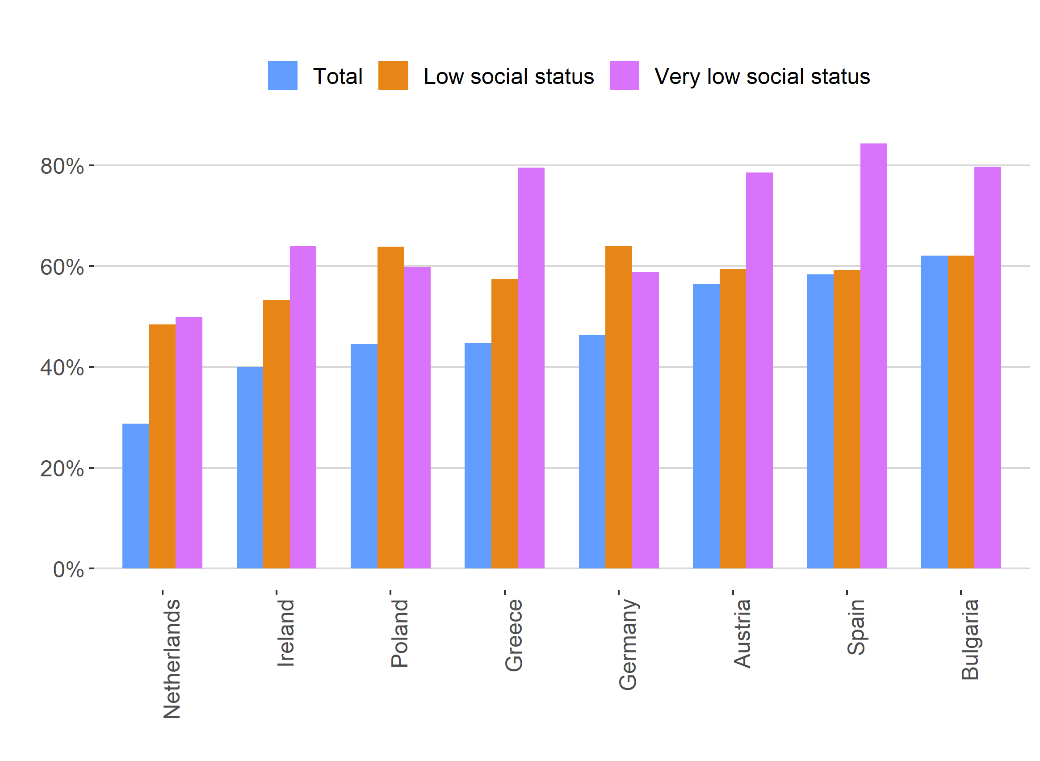
Problematic health literacy
Note: Data refer to 2015. Social status is self-assessed.
Source: Authors, based on data by Sørensen et al. (2015).

Slide 13
What determines health inequalities?

Slide 14
Institutions matter!
Economic Policy:
Labor market deregulation; fiscal policy
Social & Health Policy:
Welfare provision;
health systems
Social Determinants
of Health:
Education; occupation; income
Social Gradient in Health

Slide 15
The role of health systems

Slide 16
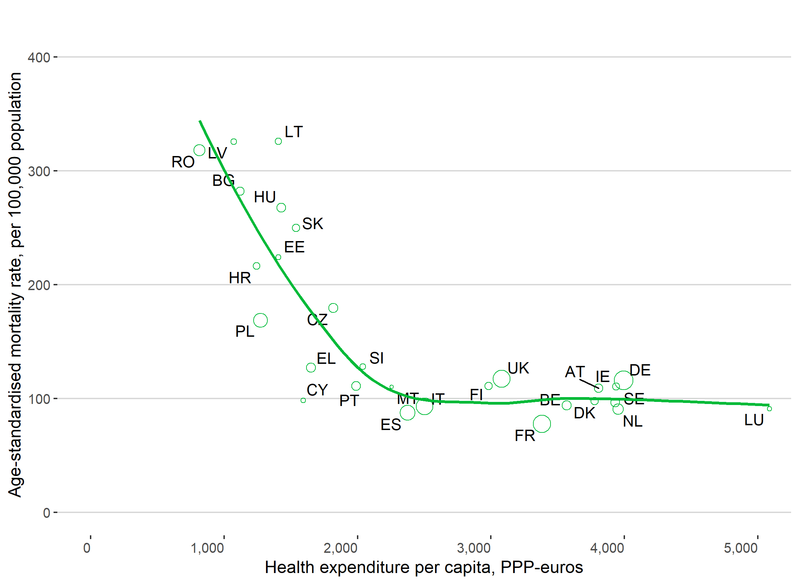
The role of health systems
Note: Data refer to 2015. Observations are weighted by the relative population size, indicated by circle size.
Source: Authors, based on data by Eurostat (2018), OECD/European Observatory on Health Systems & Policies (2017).

Slide 17
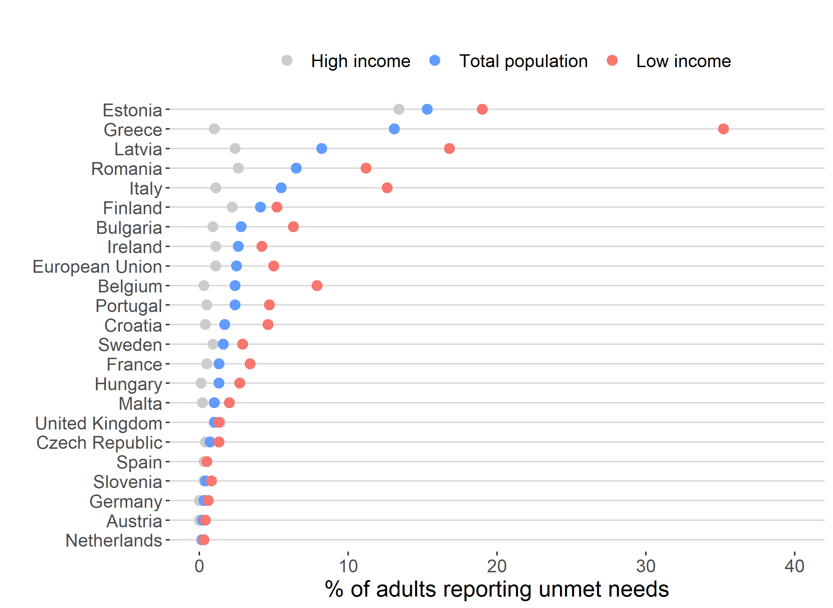
The role of health systems _{(continued)}
Note: Unmet needs for a medical examination due to costs, distance to travel, or waiting times. Data refer to 2016.
Source: Authors, based on data by Eurostat (2018).

Slide 18
The role of health systems _{(continued)}
Various health system arrangements in Europe result in differential population coverage, but high in most countries
Even so, higher socioeconomic status may carry benefits in terms of accessing health services (e.g., due to income, health literacy, social support, or personal networks)
Individuals in particularly vulnerable situations:
Unemployed or atypical forms of work
Lacking citizenship, e.g., migrants
Ethnic minorities, e.g., Roma populations
Unmet needs socially patterned across the entire population

Slide 19
The role of economic policies

Slide 20
The role of economic policies
Institutional complementarities: different policy elements (e.g., health and social policy, economic regulation, and allocation of resources) fit together
The link between economic policies and health systems varies across the EU: Social health insurance-based health systems rely more heavily on employment contributions; tax-based health systems depend on fiscal policy.

Slide 21
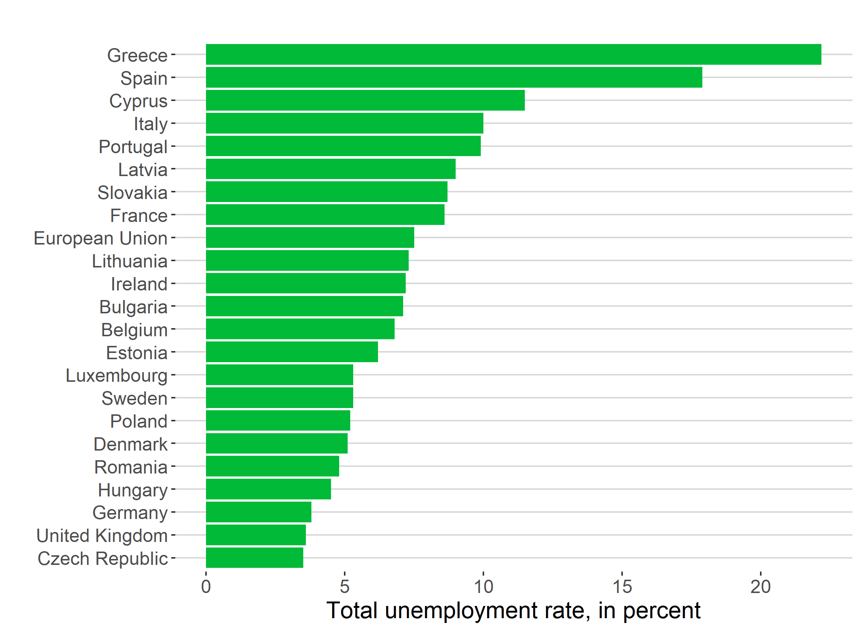
The role of economic policies _{(continued)}
Note: Total unemployment rate is the annual average as a share of the active population, from 25 to 74 years. Data refer to 2016.
Source: Authors, based on data by Eurostat (2018).

Slide 22
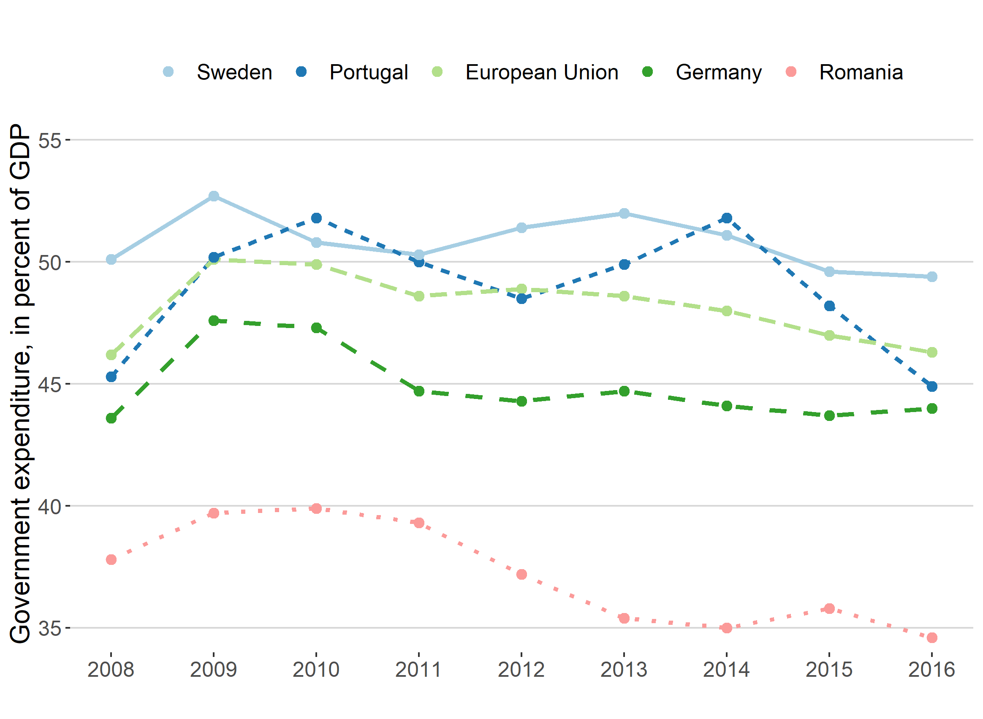
The role of economic policies _{(continued)}
Note: Government expenditure refers to total general government spending.
Source: Authors, based on data by Eurostat (2018).

Slide 23
The role of social determinants of health

Slide 24
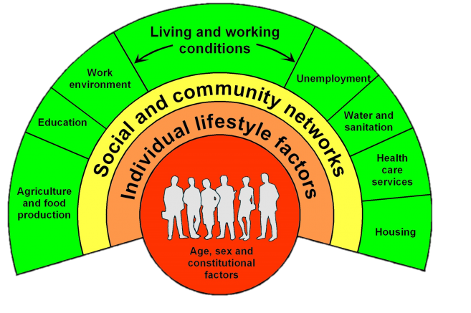
The role of social determinants of health
The conditions in which people are born, grow, live, work, and age have important implications for population health and health inequalities.
Source: Dahlgren & Whitehead (1991).

Slide 25
The role of social determinants of health _{(cont’d)}
Good work
✓ Higher wages
✓ Self-worth
✓ Social networks
Precarious Employment
✕ Stress and Insecurity
✕ Long working hours
✕ Lower wages
Note: Percentage of employees aged 20 to 64. Data refer to 2016.
Source: Authors, based on data by Eurostat (2018)

Slide 26
What is the impact of health inequalities?

Slide 27
The cost of health inequalities
Good health empowers individuals by allowing them to make better, informed choices regarding their lifestyle and health service access and utilisation.
Ill-health associated with
a) substantial welfare costs; and
b) sizeable economic costs, due to absenteeism, unemployment, and lower productivity.

Slide 28
A word of caution: We know a lot, but we could know more

Slide 29
Future research
Better document the human, social and economic consequences of health inequalities.
Focus on systematic analyses on what can be done to reduce health inequalities, rather than merely documenting the extent of health inequalities.
Adopt an intersectional approach in research: study populations at the intersection of different demographic elements (e.g., gender, migrant status, or ethnicity).

Slide 30
A progressive agenda for action

Slide 31
Action on Health Inequalities
Universal Healthcare Coverage
Labour market regulation
Social fiscal policy
Health-related behaviour
Access to education
Health impact assessments

Slide 32
Thank you!

