Slide 1
Employment Policy Breakfast Series
FEPS
09/20/2022
Tackling Labour Market gender inequalities from an EU perspective
Is the EU equal pay policy a failure?
S
Sophie Jacquot (USL-B, IEE, CReSPo)
sophie.jacquot@usaintlouis.be

Slide 2
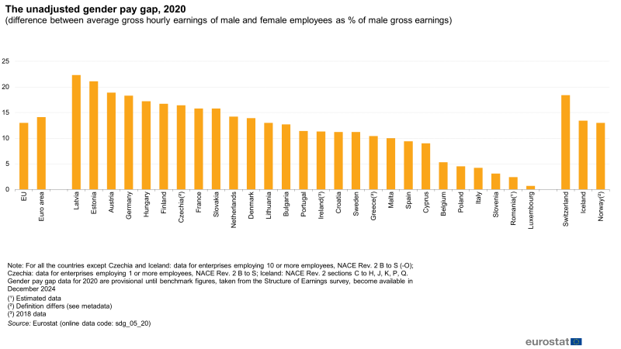
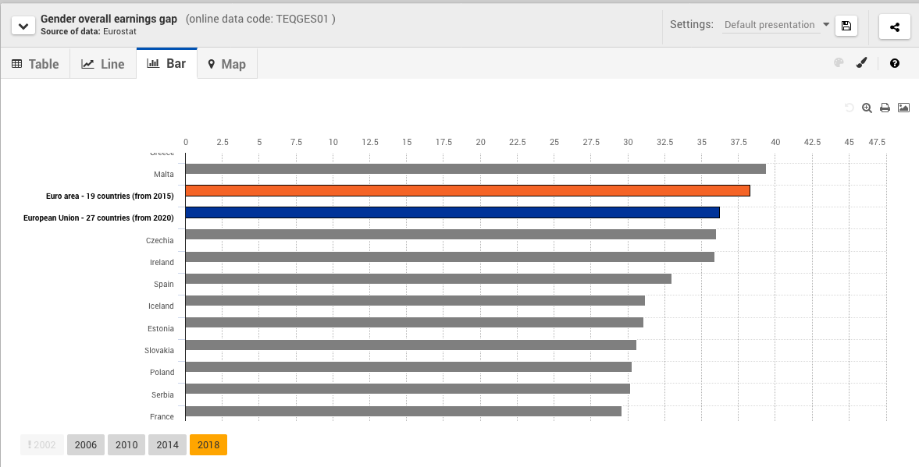
Gender pay gap (EU, 2020) : 14,1%
Gender overall earnings gap (EU, 2018) : 36,7% (average hourly earnings, monthly average number hours paid, employment rate)

Slide 3
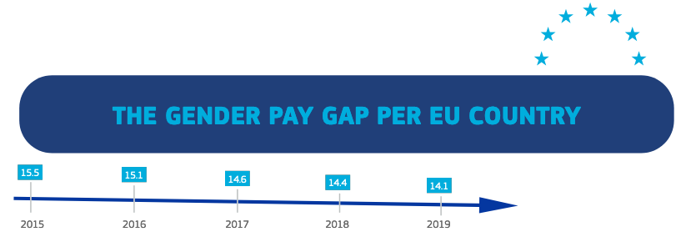
1. The paradox of equal pay at the EU level
Primary law: art. 119 EEC (now 157 TFEU)
Secondary law: Directive 75/117/EEC + Directive 2006/54/EC (“recast”)
Case law: 65 cases in 2019 (EELN)
Soft regulation: EC’s multiannual AP and strategies, EU economic and social governance (EES, Lisbon Strategy, EU2020, EPSR)
> How to deal with persisting failure?

Slide 4
2. Some lessons from the implementation of the 2006 directive
The role of political will and orientation
 | Barroso I (22/11/2004-31/10/2009) | Barroso II 10/02/2010-31/10/2014) | Juncker (01/11/2014-01/12/2019) | von der Leyen (01/12/2019-)
Implementation and evaluation initiatives (Commission) | - Communication | - Report on the application of the directive - Recommendation | - Action Plan - Report on the implementation of the Recommendation - Public consultation | - Evaluation of the existing framework - Proposal for a directive on pay transparency
Initiatives by other institutional actors / level of pressure on the policy process | Medium (1 EP resolution) | High (2 EP resolutions, 1 Council conclusions) | High (1 EP resolution, 1 Council conclusions) | High (1 EP resolution, 1 Council conclusions)
Policy density | Medium | High | High | High
Policy intensity | Low | Low | Medium | High

Slide 5
Different conceptions of equal pay (framing of the issue)
Substantive understanding of equal pay
Narrow understanding of equal pay
3. Pay transparency, a rocky road ahead
Comparison of the legislative processes of several social directives in the EP (Copeland, Elomäki, Gaweda, 2022)
Importance of political will in turbulent times

