Slide 1
Gender Inequalities in the Labour Market
FEPS Employment Policy Breakfast Series
20 September 2022

Slide 3
Putting rights into practice through policies with leverage
Solid EU legal basis for the to ensure gender equality in employment
Number of paradoxes, contrasts and contradictions;
From old to new forms of inequalities

Slide 4
Reassessing gender inequalities in the labour market
ACTIVITY
Progress of female labour market participation
WORK
UNEMPLOYMENT
UNDEREMPLOYMENT
Rising feminisation and service-based workforce
shifting social norms + higher female educational attainment
Horizontal & vertical segregation of the labour market
Gender constructed norms of “female” vs “male” jobs
Gender pay gaps
inequality
insecurity
invisibility
Part-time work = women’s work?
Choice?
Atypical work: working time, salary, qualification
Formal vs. informal work
Underpaid, undervalued
Motherhood penalty
- Art 157 TFEU
- 2006/54/EC recast directive
- Pay Transparency Directive
Unemployed vs. ‘housewives”
Double shift
productive vs. reproductive economy
(in)direct discrimination
Based on: Margaret Maruani (2017). “Travail et emploi des femmes”, Editons La Découverte, Paris

Slide 5
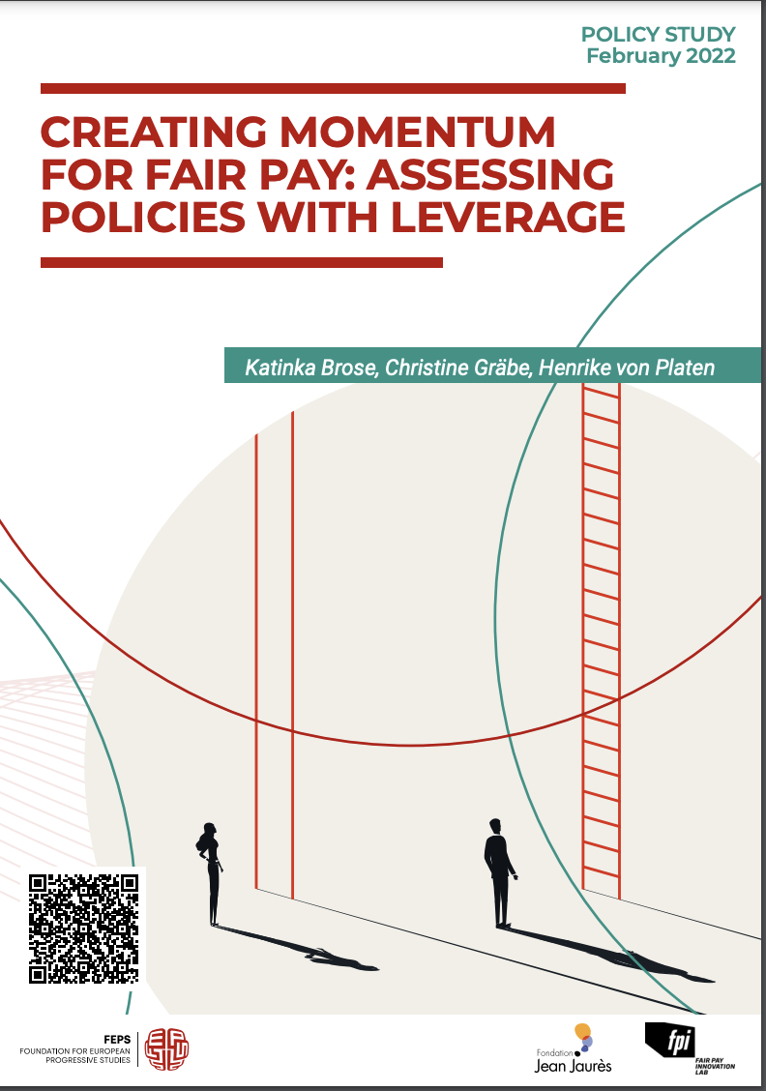
POLICY STUDY (2022)

Slide 6
Objective
assess different policy instruments to ensure fair pay
discuss their leveraging effects
Results
mandated analysis of remuneration systems is key to achieving fairness for all
putting fair pay into practice is a systemic issue and not an individual burden.
most effective levers for fair pay are corporate action, regular analysis of pay systems, and benchmarks combined with fines.

Slide 7
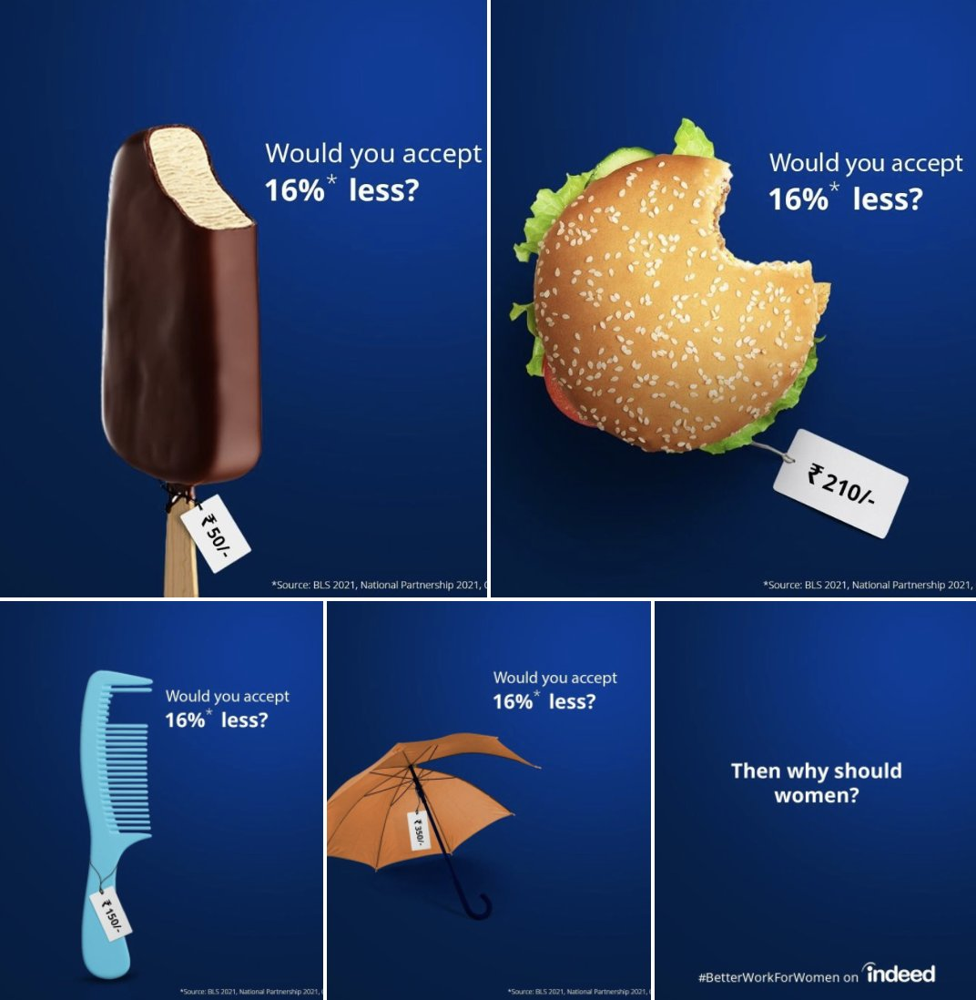
Why does it matter ?
the gender pay gap (13%) has narrowed only marginally within the past years
differences between the member states of the EU are remarkable
none of the countries has managed to close their pay gaps entirely.
Research has shown positive effects on various transparency, reporting, and auditing instruments.
one in four companies implementing transparency measures went further than the legal requirements (Eurofound).
impact assessments have shown the potential of systematic analysis of fair pay and pay transparency: for every percentage point the gender pay gap closes in the EU, the GDP may increase by +0.1 percentage points.
value of work and how to measure jobs
The pandemic highlighted the systemic undervaluing of women’s work
highlighted the gender segregated LM and the differences in pay between those sectors where the majority of women work.
PT = 1st step towards closing the GPG → opportunity to take equality seriously.
Source: Indeed

Slide 8
National Approaches implementing fair pay
UNITED KINGDOM | SWITERLAND | ICELAND | GERMANY | FRANCE | SWEDEN
Radical Transparency | Regular Pay Analysis | Standardising Fair Pay | Focus on Individual Action | Index + Gender Equality Standard | Holistic Approach “Fix The System, Not The Women”

Slide 9
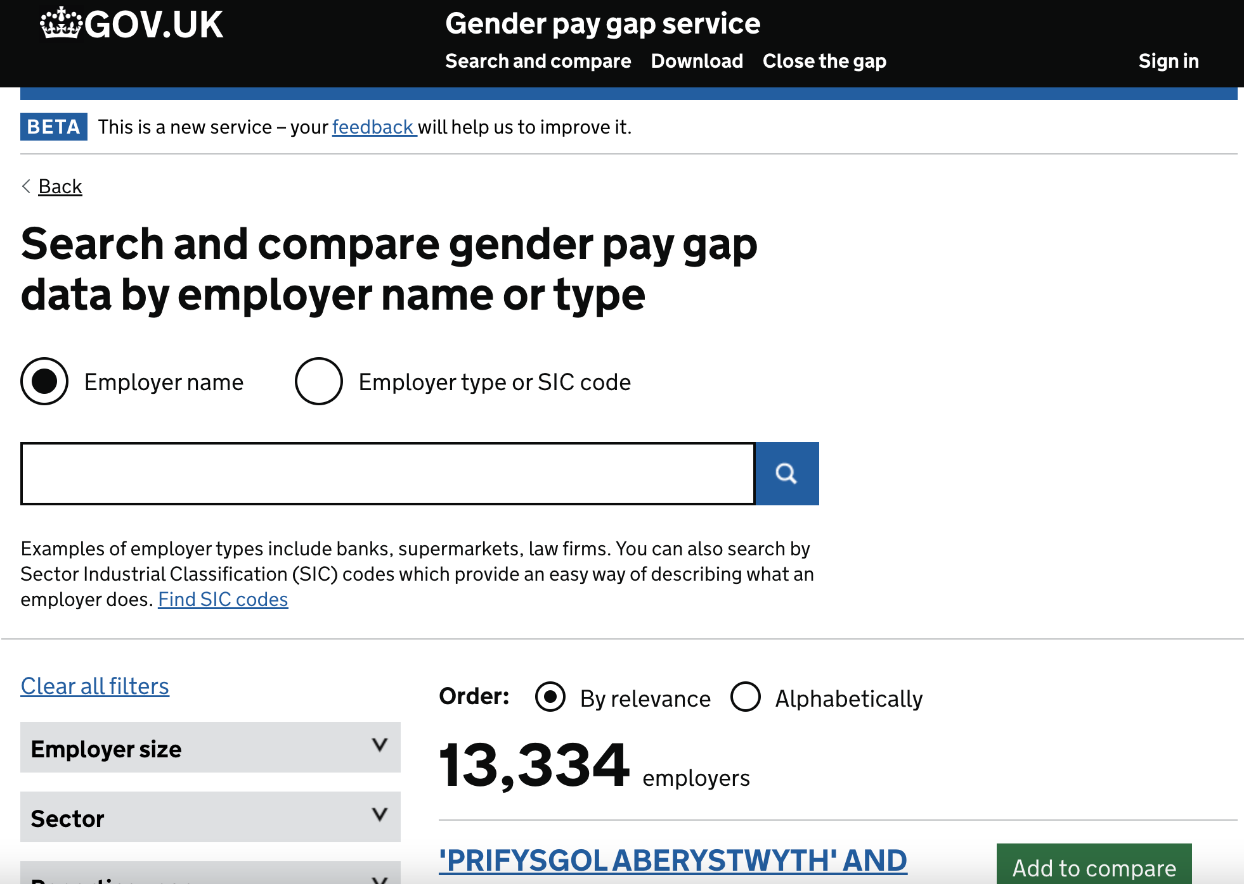
National Approaches implementing fair pay
UNITED KINGDOM
Radical Transparency
2010 Equality Act Publish data (available to all) on their gender pay gaps if 250+ employees. → triggered huge interest in GPG: shifted conversation towards fair working conditions for all + further advances (other grounds) Covid-19: reporting deadline moved (fatal signal that GE not so important). ! PT = essential to drive PG down and to stir the debate on fairness. BUT reporting without sanction if non-compliance/lack of immediate legal action when discri. practices detected will not be able to close GPG entirely (N&S only 1st step).
Source: https://gender-pay-gap.service.gov.uk/

Slide 10
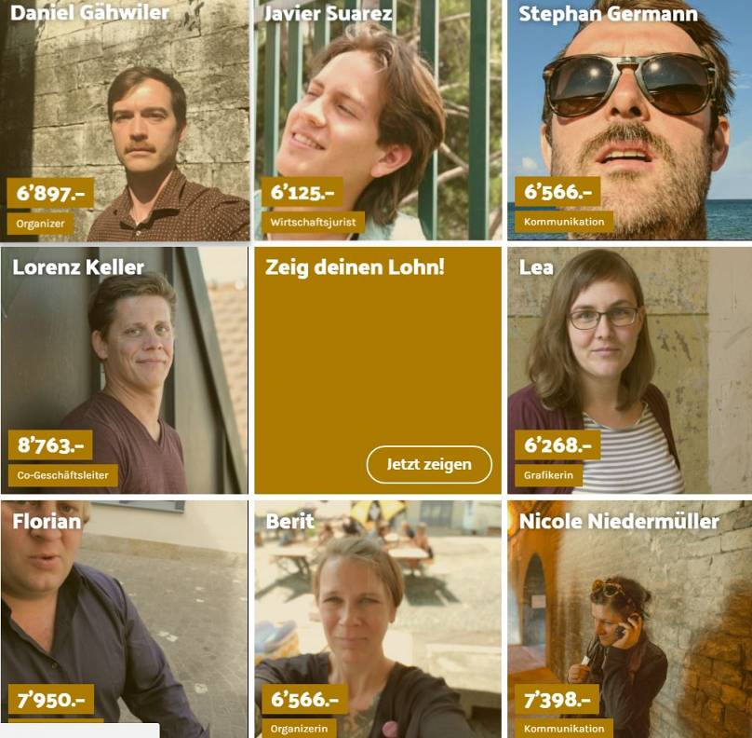
National Approaches implementing fair pay
SWITERLAND
Regular Pay Analysis
2020 Equality Act Business 100+ employees have a deadline for checking their pay structures. By July 2021 they had to carry out a pay analysis (every 4y). Swiss federal office for GE provides standard tool for analysis: allows companies from 2 employees to run analysis easily themselves. Results checked by independent body - in private sector- made available to employees/shareholders; - In public: openly published
Source: Euronews (2018)

Slide 11
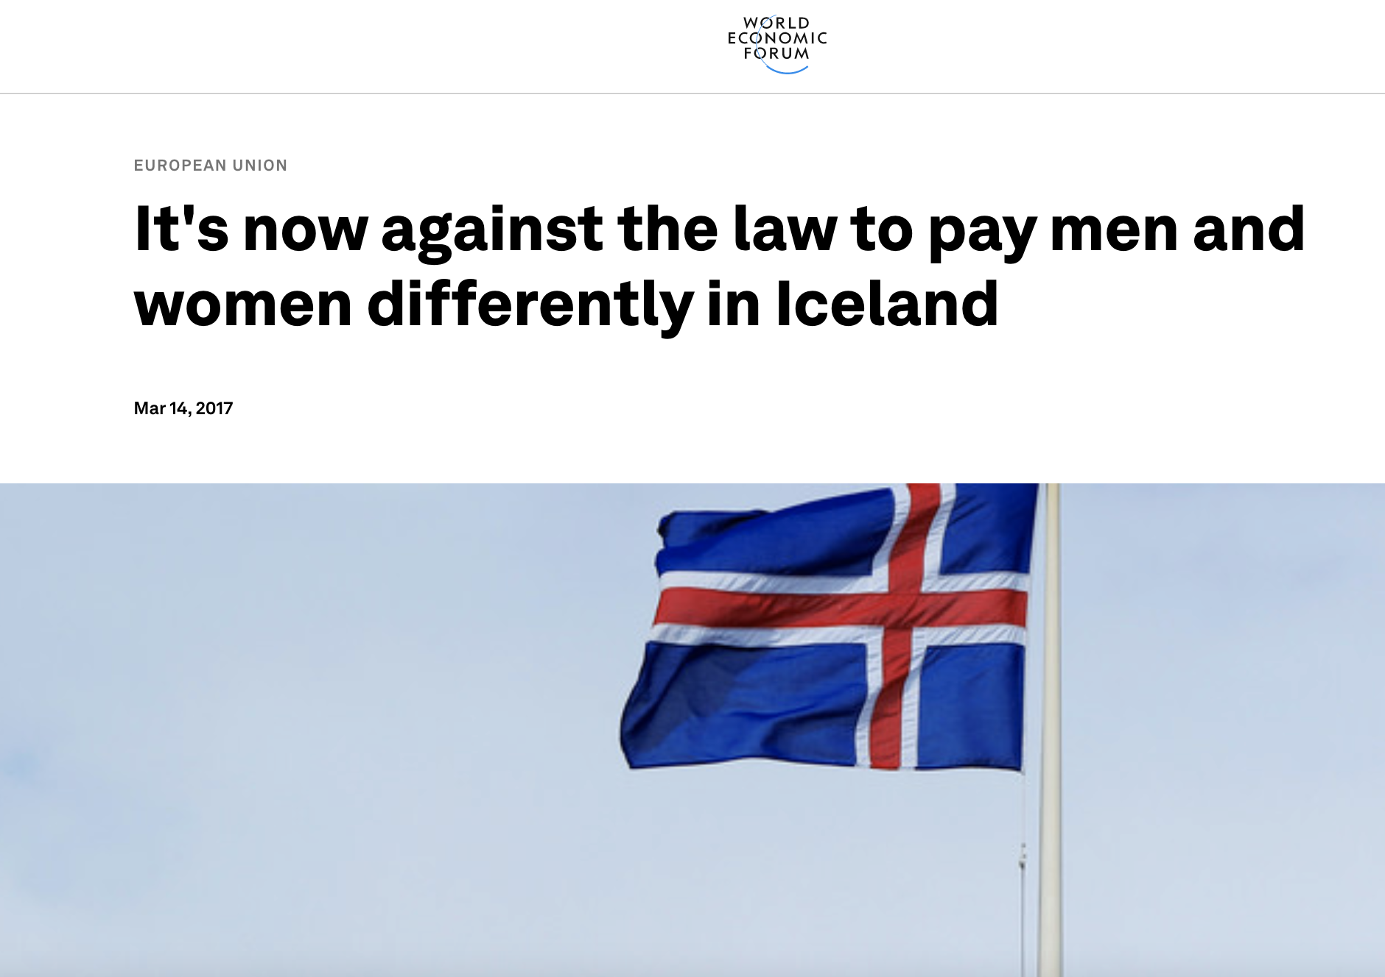
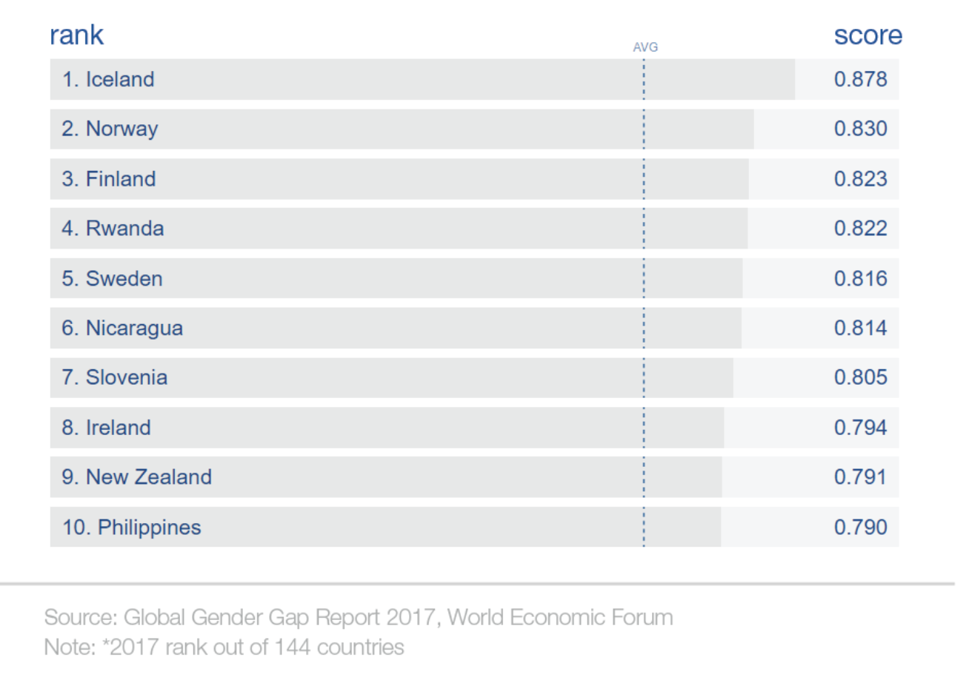
National Approaches implementing fair pay
ICELAND
Standardising Fair Pay
2017 Equality Act audit/certification scheme for all companies 25+ employees. ! Any entity that fails to comply must pay a fine for every day uncertified (400 EUR / day). Certifications must be renewed 3 years → ensure fair pay to employees. +/ Center for GE keep a register for companies with(out) certification. 2020: EA updated again: ensure FP for all persons regardless of gender. = revolutionary provision in its design ! → Demonstrates leading position on equality and fair pay.

Slide 12
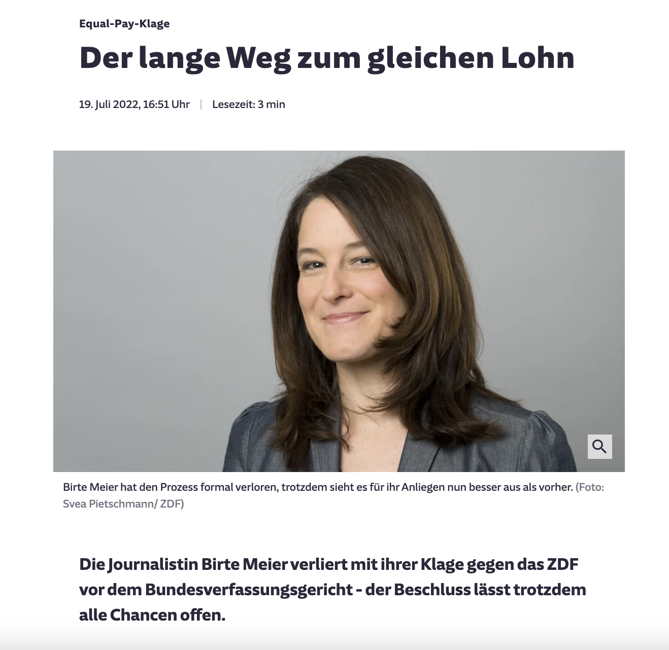
National Approaches implementing fair pay
GERMANY
Focus on Individual Action
Wage Transparency Act Companies with 500+ employees obliged to report on the share of w/m and invited to review their pay structure. ! major focus laid on the individual right to disclosure. Employees in companies 200+ employees can ask for a comparative wage. Only 4% of the employees have used their rights to disclosure within two years making the law failing its intention. If unequal payments are discovered, employees can though sue for a corresponding salary adjustment. → rarely used, only a few court cases opened since the enactment of the law.
Source: Sueddeutsche (19 July 2022)

Slide 13
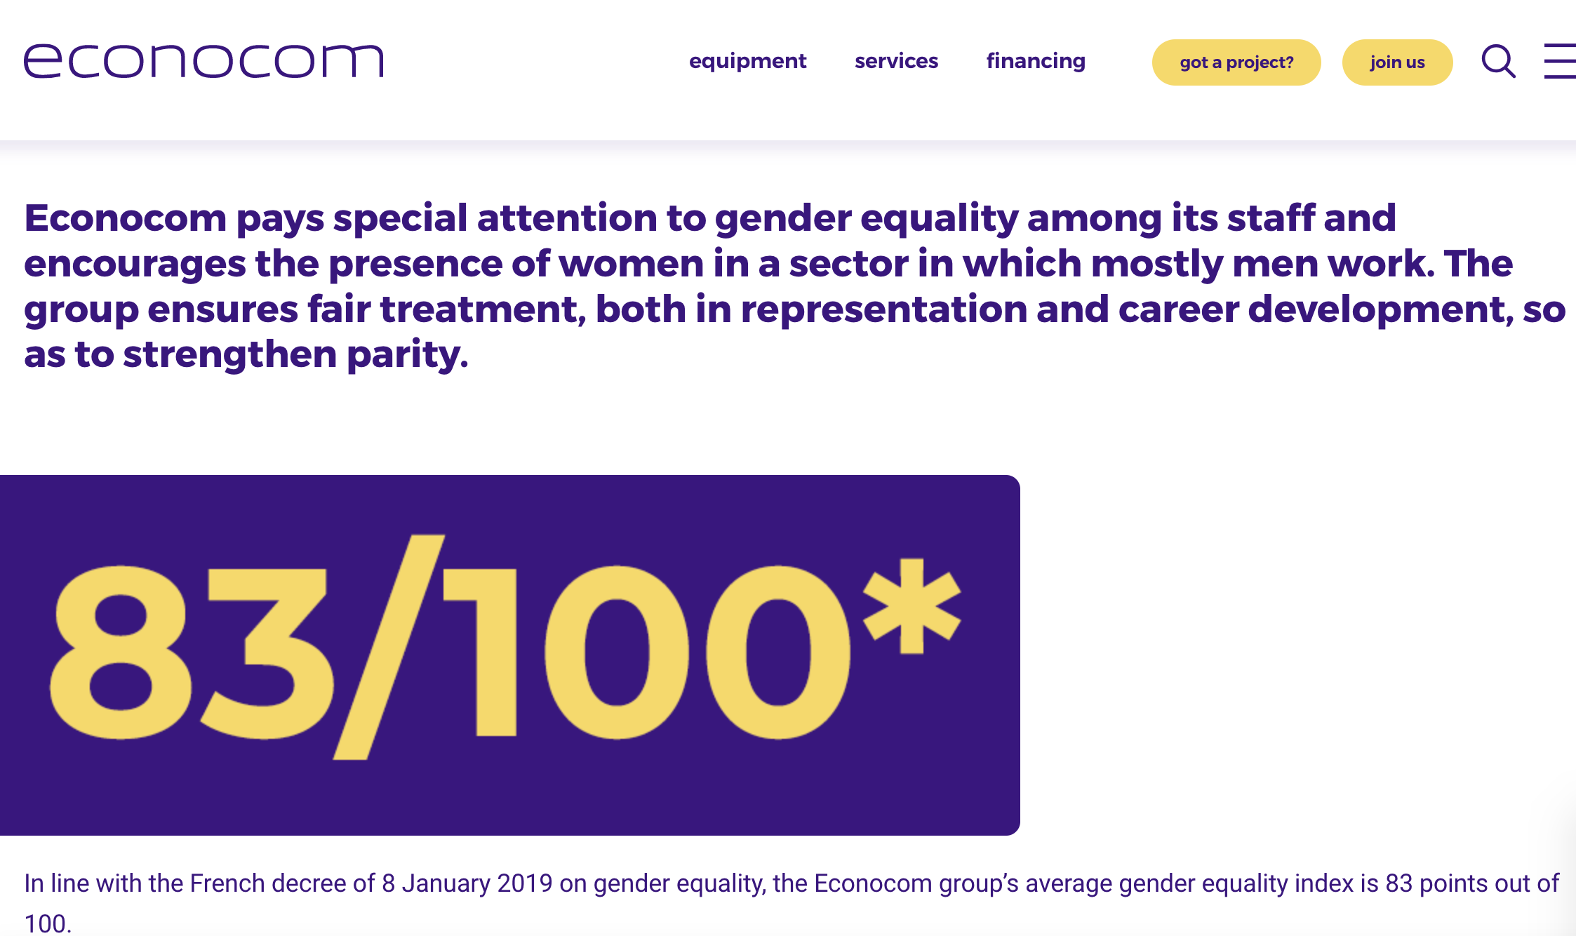
National Approaches implementing fair pay
FRANCE
Index + Gender Equality Standard
2018 legally binding Gender Equality Index: Companies 50+ employees obliged to calculate index (100 pts) and yearly publish their score. If they under 75p, fines are imposed, and changes are mandated to close the gaps. 1. gender pay gap 2. difference in the distribution of salary increases 3. difference in the distribution of promotions 4. number of employees increased on their return from maternity leave 5. number of people of the under-represented sex among the 10 highest paid positions scores of companies with 250+ employees can be accessed via a government portal. index combines various challenges women face in the LM : +complete picture of equal opportunities.
Source: Econocom

Slide 14
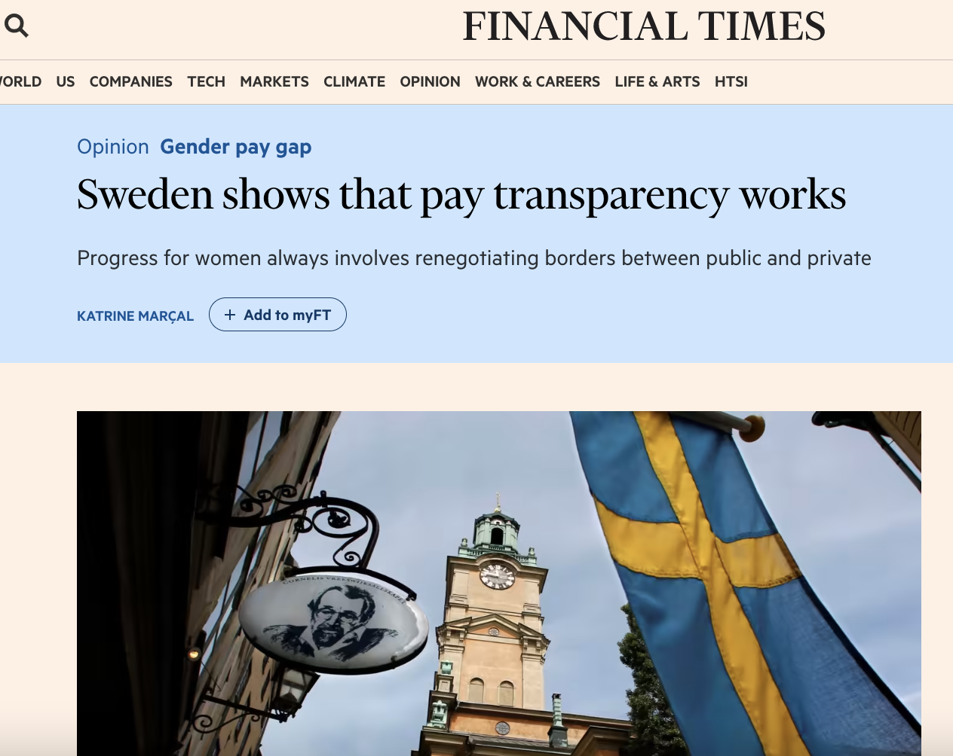
National Approaches implementing fair pay
SWEDEN
Holistic Approach “Fix The System, Not The Women”
The heart of Swedish policies is the individual: individual taxation in → individual economic independence as a focal point → motivated many women to work (full-time) Combined with a coherent strategy on day-care for children, a more egalitarian share of work and care does not remain a wish among many couples but is lived reality. transparency and fairness both enshrined in the Swedish way of life. Everybody can check the wages and taxes of others at the Swedish tax office. Since 2016, companies with 25+ empl are required to submit reports on state of equality. If gaps are found, it is mandatory to close these gaps otherwise fines can be imposed on the respective company.
Source: Financial times (2017)

Slide 15
Level of effectiveness of measures for fair pay

Slide 16
Policy recommendations
1. Transparency and reporting
2. Sanctions and immediate legal consequences
3. Moving beyond the binary
4. Focusing on all organisations rather than solely on companies
5. Following a systemic approach
6. Changing the value of work

Slide 17
Thank you.
Find out more on : https://feps-europe.eu

